Slide 1
Story of Ebola Outbreak-2014
Audience:- Health organizations, Governments and general public
Data:- World Health Organization(WHO),Center of deiseases prevention(CDC),Funds Tracking System(FTS),International Air transporation Association(IATA)
Task:- To tell the story of ebola outbreak.where it started and where is it going? How are governments and Organizations reacting ?
Team Members
Andrea Sartor
Manas Praharaj
Justin Nowell
Viswanath Kammula

Slide 2
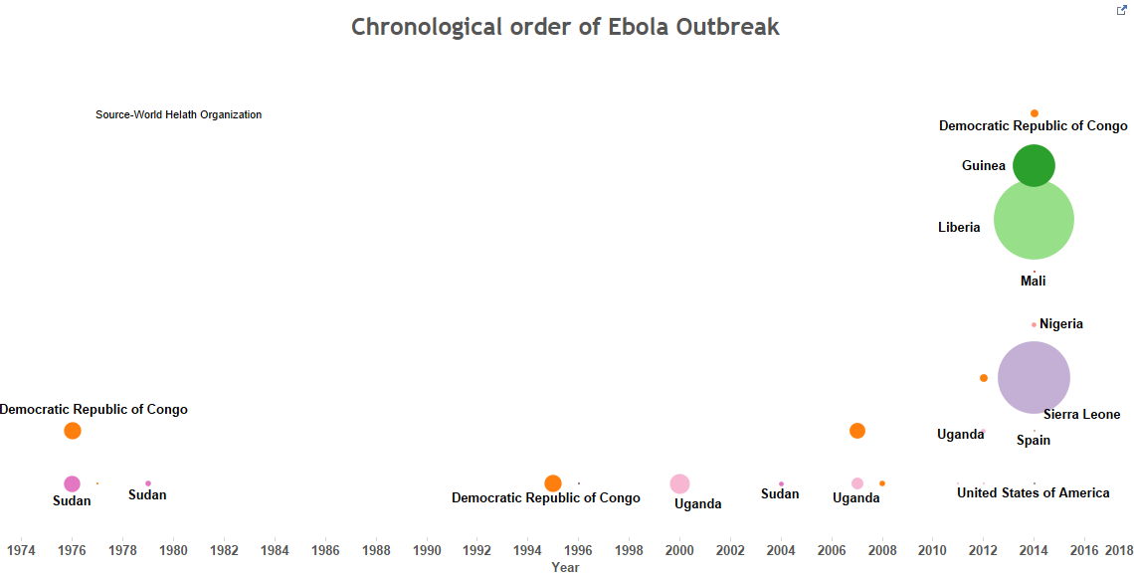

Slide 3
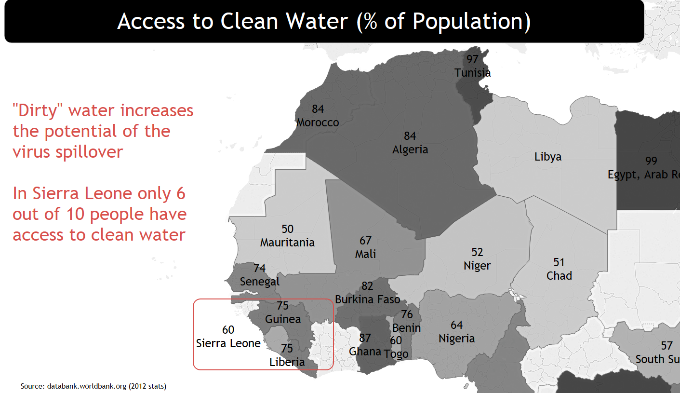

Slide 4
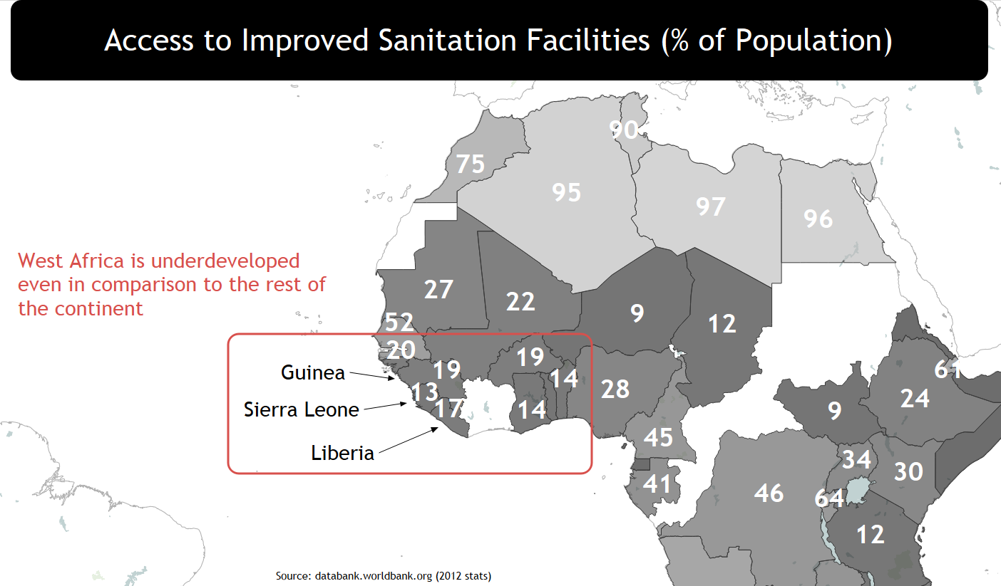

Slide 5
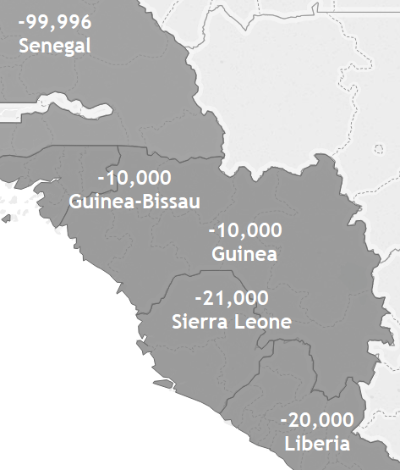
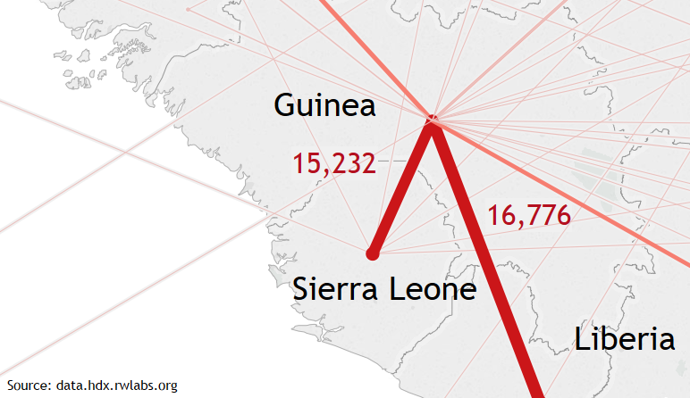
West Africa: High Population Mobility
Net migration:
lots of emigrants
High mobility within the region
made possible by weak borders protection
Migration patterns based on Census microdata
Source: databank.worldbank.org (2012 stats)

Slide 6
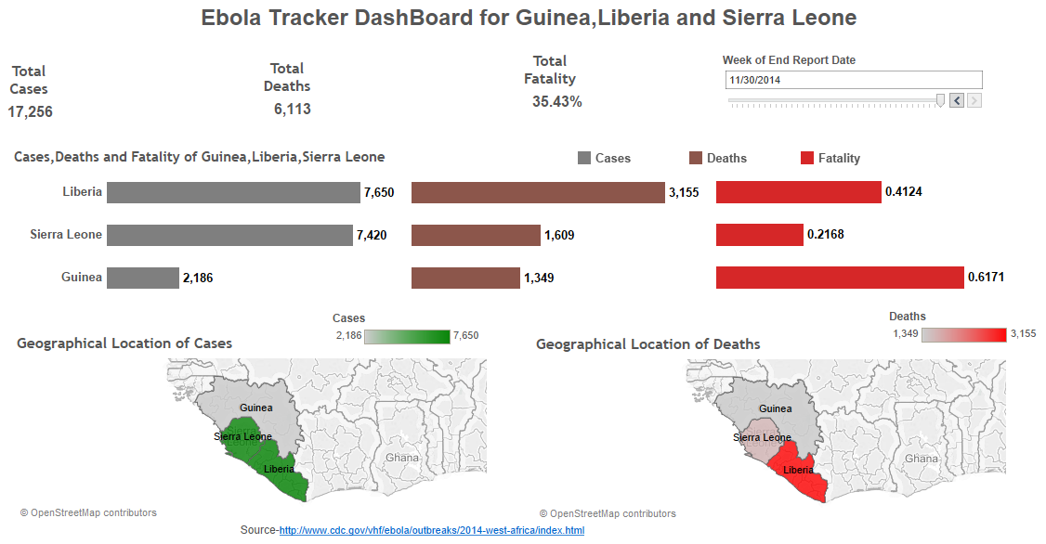

Slide 7
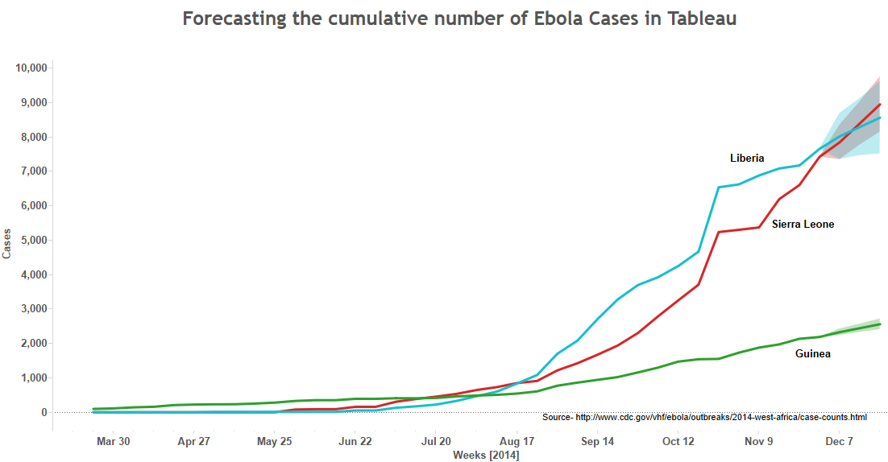

Slide 8
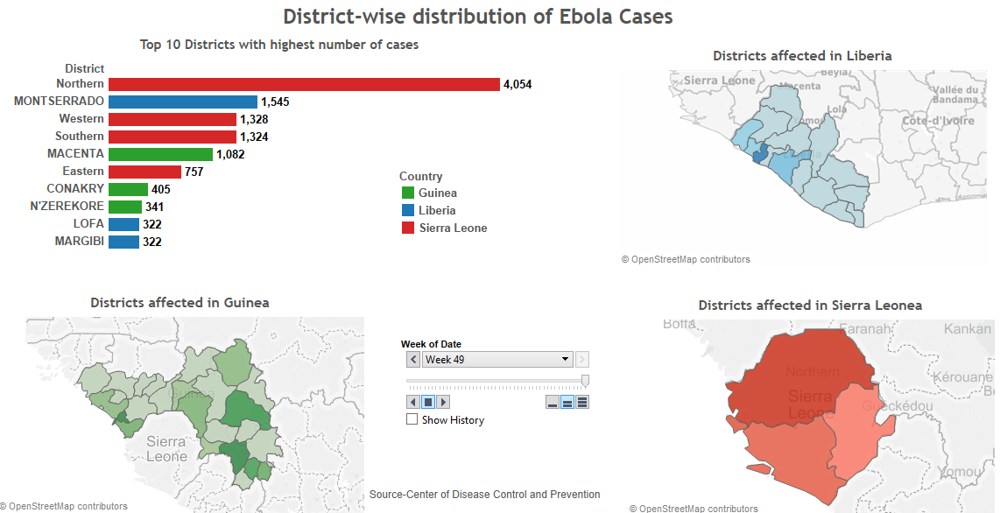

Slide 9
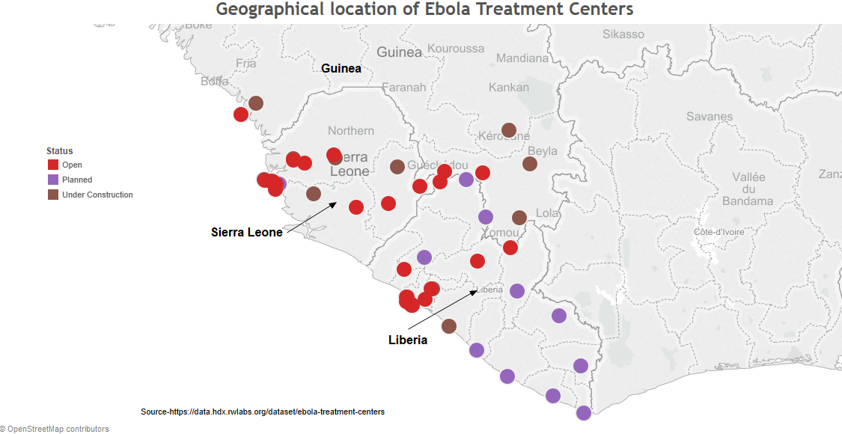

Slide 10
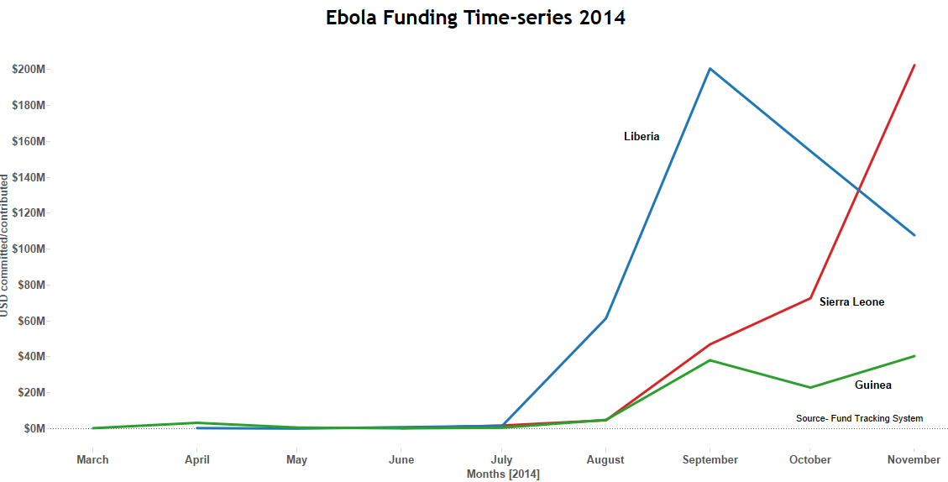

Slide 11
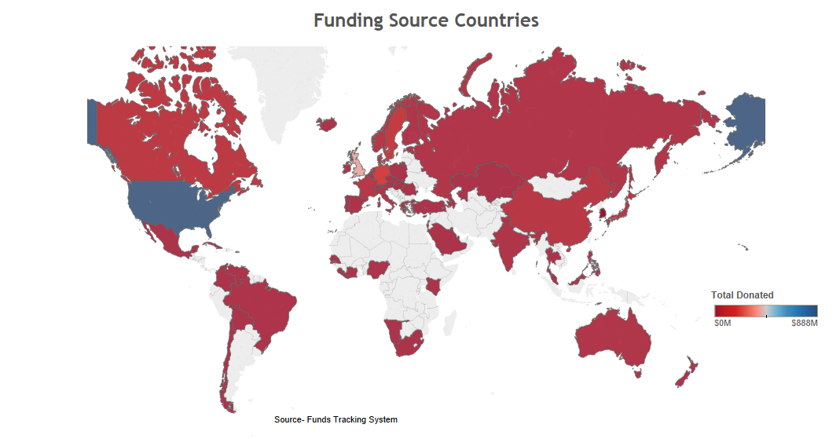

Slide 12
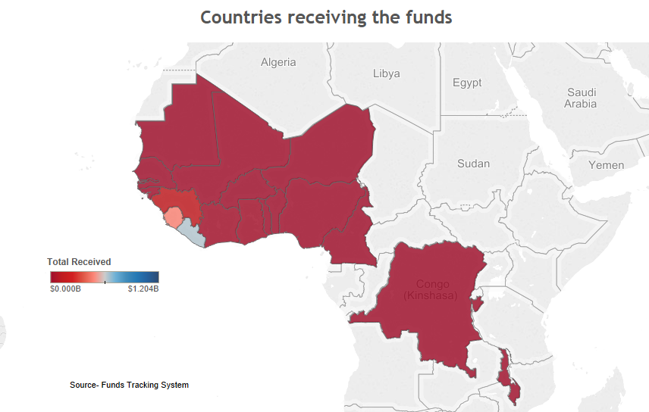

Slide 13
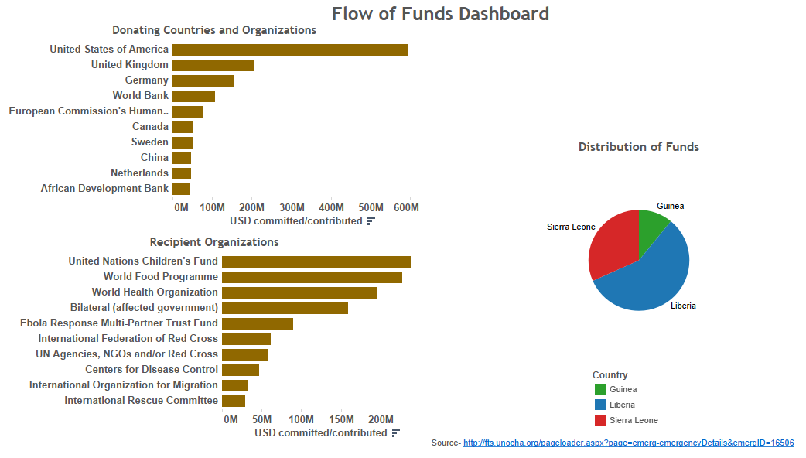

Slide 14
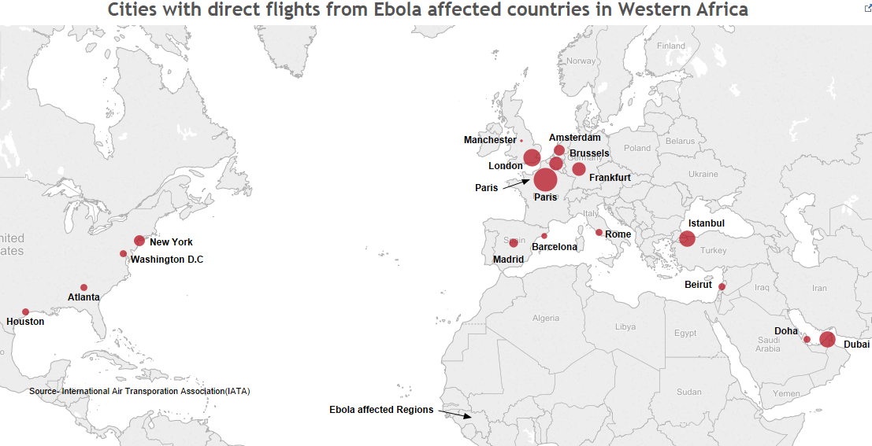

Slide 15
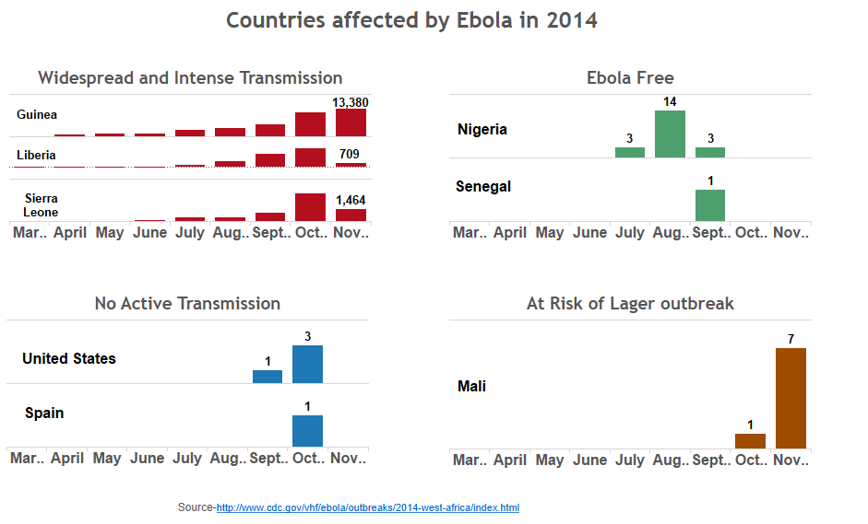

Slide 16
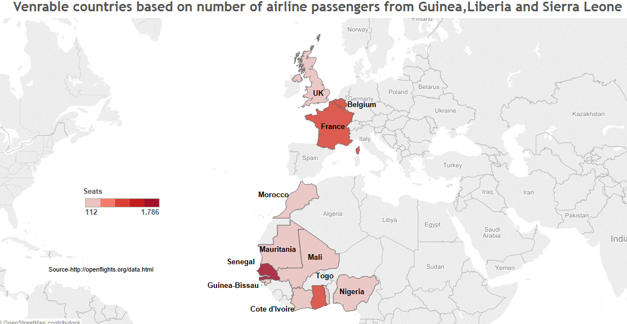

Slide 17
